Slide 1
Report from the trenches of an HTML5 game provider

Slide 2
About SOFTGAMES
A leading developer of the most popular Instant Games for Facebook Messengers
Operating the world’s largest platform for HTML5 games distribution
Notes:
SOFTGAMES is a leading developer of the most popular Instant Games for Facebook Messengers with millions of users every month.
Further SOFTGAMES is operating the world’s largest platform for HTML5 games distribution and monetization outside the Messengers.
Our vision is to help users to instantly play great games with their friends, while helping brands to reach their target audiences.

Slide 3
Outline
Challenges of web game development 2019
Notifications
Loading and storage
Offline play
Piracy
Multiple Devices
Discovery
Notifications
Monetization

Slide 4

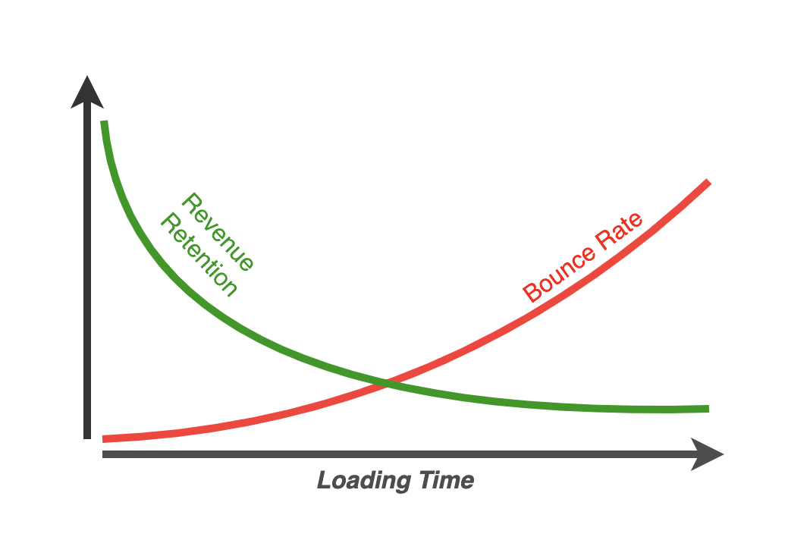
Loading & Storage
Platform Goal: <500ms TTFB
Game Goal: <3s to Start
Notes:
Loading time is one of the most critical elements of Games UX, and the main reason player abandon games.
Goal would be a 3s loading time median
Casual game developers intend to load everything upfront
Conflict between fast loading and seamless play
Conflict between fast loading and offline play preparation
What about games in webviews

Slide 5

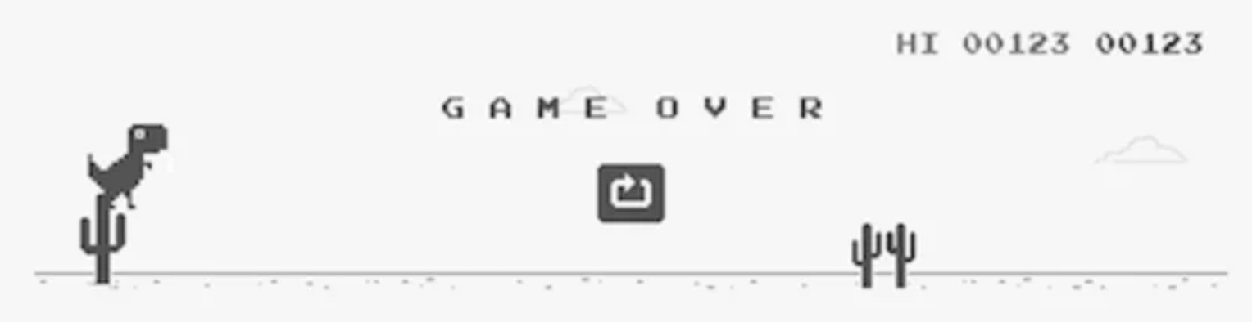
Offline Play
Full game but without monetization and backend
‘Mini game’?
Notes:
A key advantage of native downloadable games over web games is the easy ability to play offline.
progressive web app
App cache manifest
Offline play is a possible, but very daunting technically. Perhaps this can be improved?
Users need an easy way to access their offline games: at the moment, adding a website to the homescreen is a complex task that most users might fail at.

Slide 6



Piracy
Obfuscation
Uglification vs beautifier
De-obfuscators.
Idea: ‘runtime code’
Result: We don’t care, as it is high effort on casual games.
Notes:
We often find code and assets of our games being used by other developers.
We hope to share examples, and ideas on possible solutions.
threshold for flash was little higher as it was ‘compiled’
web is max obfuscated/uglified
browser content can be copied

Slide 7



Multiple Devices
Options
Login
Fingerprint
IP-address (location)
Combination
Problem
Interruption
Privacy
Notes:
Allowing the users to seamlessly switch browsers and devices while maintaining game progress and data can improve UX immensely.
Can this be achieved without the extra friction of added registration/auth or server side solutions?
If achievable how can we protect the users privacy?
w/o user interaction
Fingerprinting https://jira.softgames.de/browse/PW-1759
with user interaction
Own user base
3rd party login
Problem:
login usually interrupts the game play and might be a drop-off point
data privacy
Best implementations: Social networks/messengers

Slide 8


Discovery
Notes:
It’s still very hard for games to get visibility and traffic.
It's clear that a solution like the App Store / Play Store is not in sight.
FB instant and other social networks are giving hope for the future.
Even after a player already played the game for the first time, it's still very hard to get back to game he liked which makes retention with web games a big challenge.

Slide 9
Discovery
Where is my game?
Notes:
It’s still very hard for games to get visibility and traffic.
It's clear that a solution like the App Store / Play Store is not in sight.
FB instant and other social networks are giving hope for the future.
Even after a player already played the game for the first time, it's still very hard to get back to game he liked which makes retention with web games a big challenge.

Slide 10

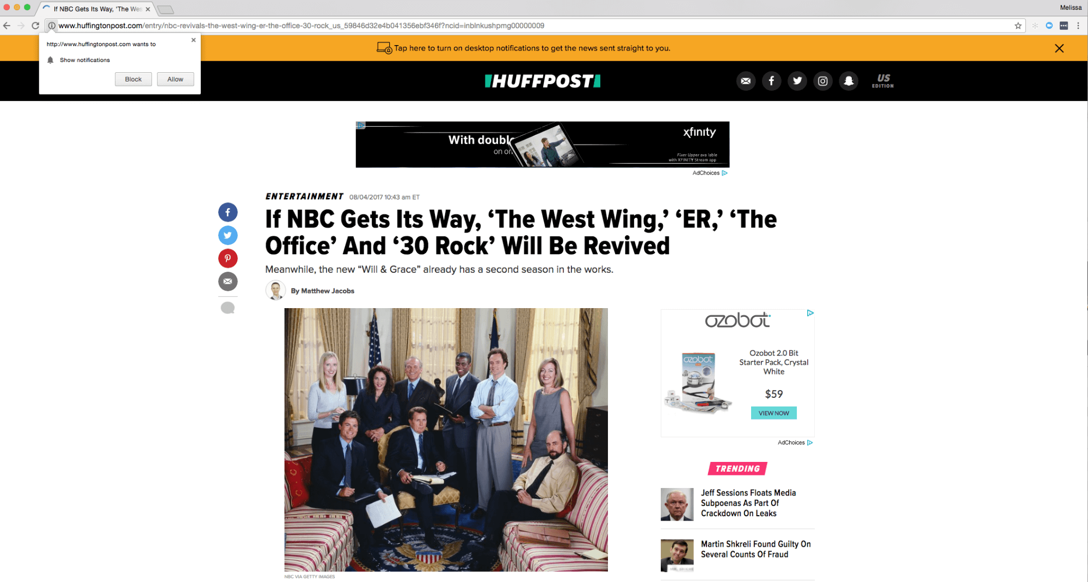
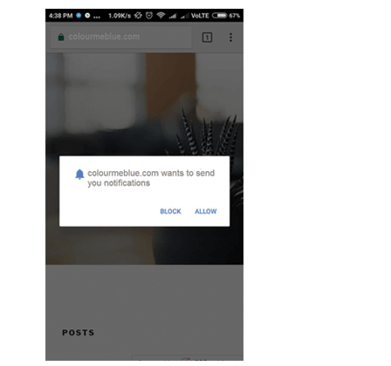


Notifications
44%
91%
5-15%
>
iOS opt in rate
Android opt in rate
Web opt in rate
https://blog.pushengage.com/definitive-guide-increase-push-notification-opt-in-rate/
https://www.accengage.com/press-release-accengage-releases-the-push-notification-benchmark-2018/
Notes:
Notifications are a key mechanic to get players back to the game. It's a common practice with native mobile games, but less common with web games.
On Facebook Instant with Bot message we see 5-10% improvement in D1RR for subscribed users.
Better support of Web Notifications & Push APIs, can help improve player retention in web games.
Improving the UX of the notification opt in is a key to the success this mechanic.

Slide 11


Shortcuts / Bookmarks
Add to home screen
Notes:
~20% of our ANDROID sessions on Facebook instant games are of returning users through the homescreen shortcut... and users returning through a shortcut have much better retention.
On web theres not yet a simple standard way for users to add a shortcut or bookmark, and its possible that a lot of less savvy users are not aware of the possibility.
Chrome Add to homescreen is a step in the right direction, but a similar solution is not yet widely supported with other browsers and the rules of its display are not transparent and not in control of the developer.
Perhaps adding an API with similar flow to the Web Notifications can improve users ability to return to games they love.

Slide 12

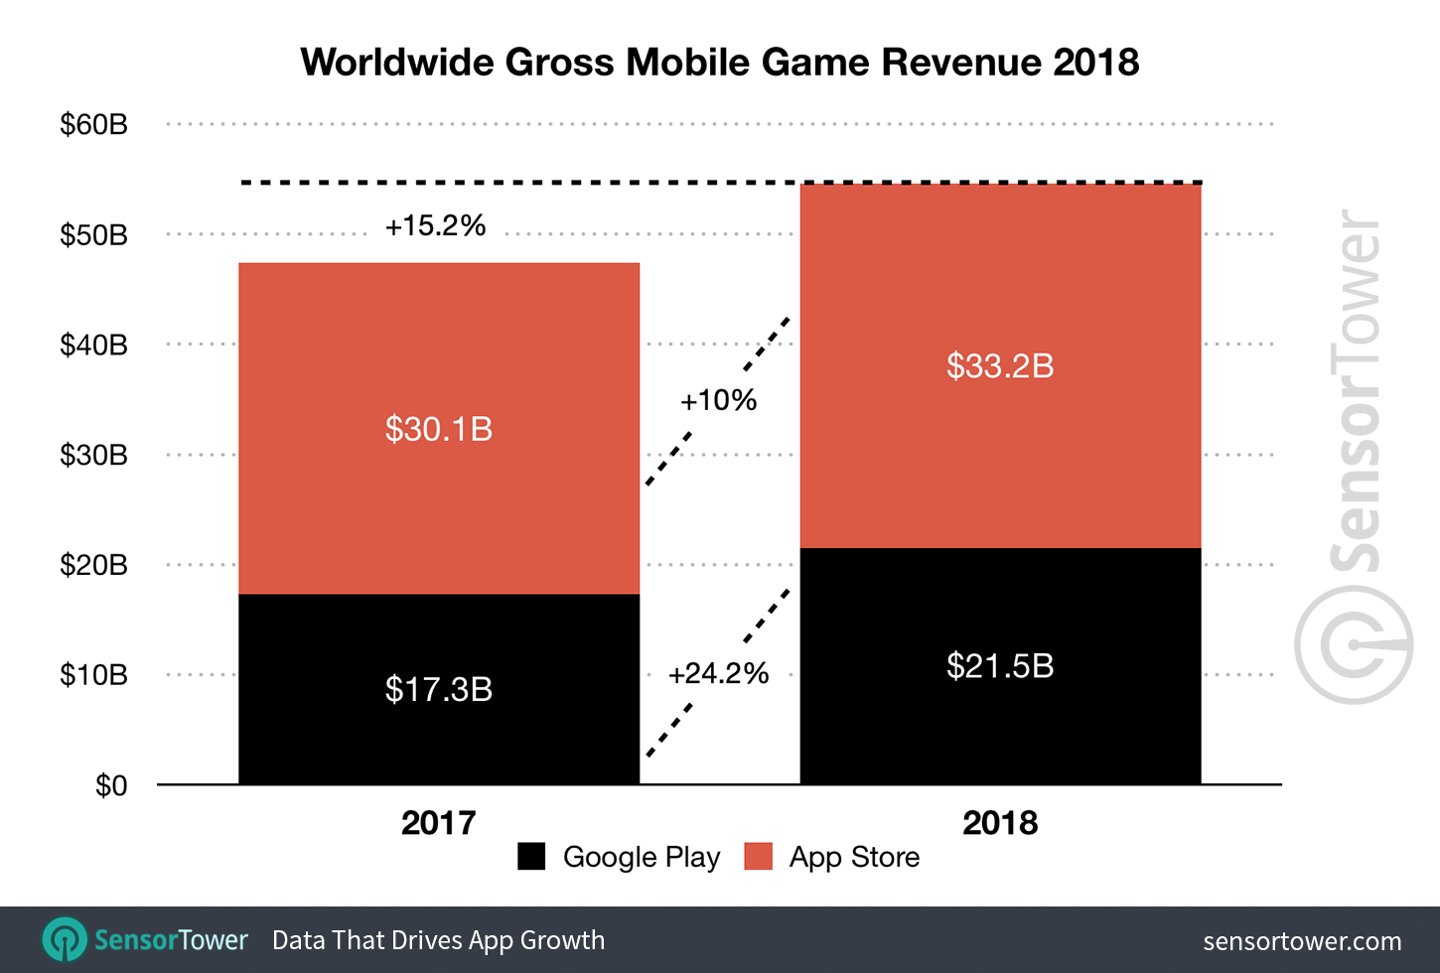
Monetization
Web Games Monetization?
In app purchase
With Payment request API?
Rewarded Ads
Missing support
Notes:
The simplicity and immediacy of payments and rewarded ads in native mobile games is driving ~$60B in revenues.
Can the Payment Request API makes payments in web games as easy?
At the moment, there's no strong solutions for rewarded ads which is a missed opportunity

Slide 13
Thank You!

